Slide 1
Privacy and Security Implications on Wireless (Wi-Fi) Tomography
J R O Sirimanne
2013 MIS 021

Slide 2
Introduction
Wi-Fi is the popular wireless networking technology using radio waves
Tomography refers to imaging by sections or sectioning, through the use of any kind of penetrating wave
Radio tomographic imaging (RTI) offers a new way to image passive objects in buildings and outdoor environments using received signal strength (RSS).
Objects can be anything including humans!
Privacy can be breach without knowing!!

Slide 3
Related Work…
J. Wilson and N. Patwari, “Radio tomographic imaging with wireless networks,” IEEE Transactions on Mobile Computing, vol. 9, no. 5, pp. 621–632, May 2010. Published, 01/08/2010.
An illustration of an Radio tomographic imaging (RTI) network. Each node broadcasts to the others, creating many projections that can be used to reconstruct an image of objects inside the network area.

Slide 4
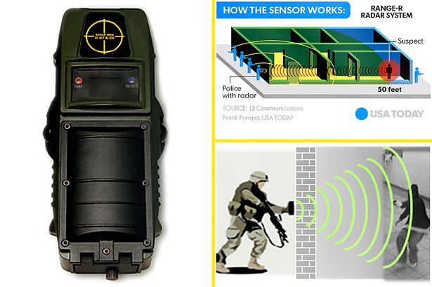
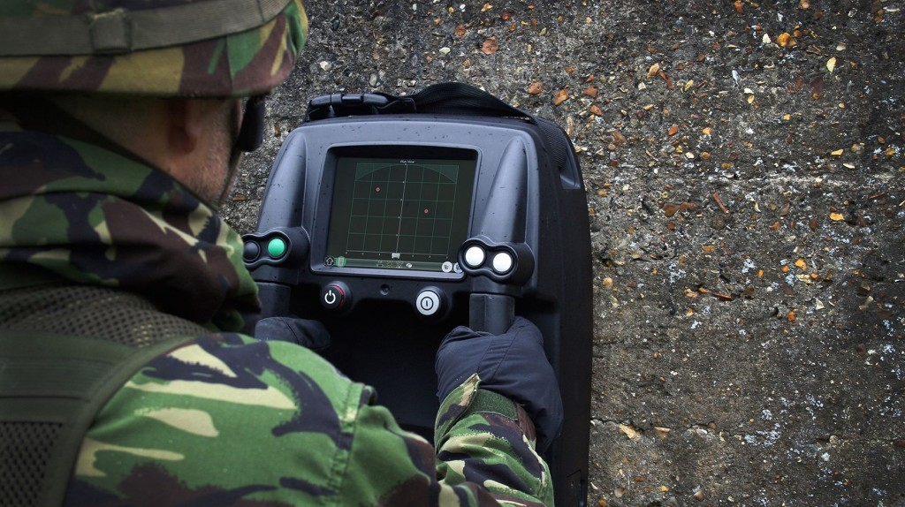
Related Work contd…
Study on wireless sensor based industrial tomography systems by Chiew Loon Goh, Nor Muzakir Nor Ayob, Ruzairi Abdul Rahim, Herlina Abdul Rahim, Muhammad Jaysuman Pusppanathan, Mohd. Hafiz Fazalul Rahiman, Leow Pei Ling, Zulkarnay Zakaria.
See through walls radar – used for military and tactical purposes

Slide 5
Goals
Implementing a test environment
Find the variation between number of wireless devices that are able to map objects.
Find the vulnerable points in UCSC

Slide 6
Methodology
Project needs a practical approach
Phase 1 – Setting up the test environment
Phase 2 – Data gathering and Analyzing
Phase 3 – Find vulnerable wireless areas that can used for tracking.

Slide 7
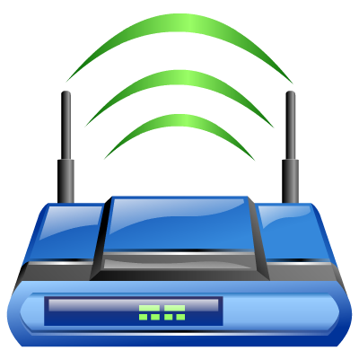

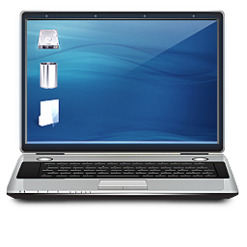
Initial Testing
Wireless access point and Laptop is in line of sight 3m apart
Laptop captures RSSi value every 0.5 second
Human is walking intersecting laptop and wireless access point
Wireless Access Point
Laptop

Slide 8
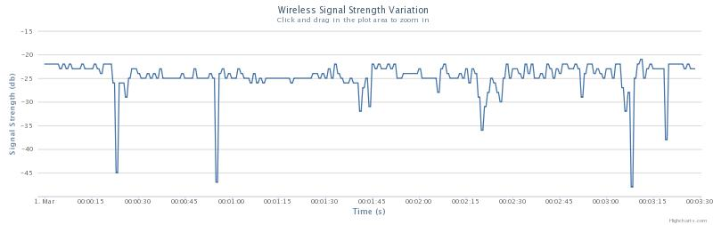
Initial Testing Results
Significant RSSi drops

Slide 9
QUESTIONS??

Slide 10
THANK YOU!

